Slide 1
The Assembly Hypothesis: Emergent Computation and Learning in a rigorous model of the Brain
Santosh Vempala
Algorithms and Randomness Center, Georgia Tech

Slide 2
What is Computation?
Well-defined sequence of state changes (with purpose)
Computation state: memory contents, input, output.
Completeness: Church-Turing “thesis”: Anything Computable can be Computed by a Turing Machine.
TM = finite-state machine + tape

Slide 3
Computation is Universal
Planetary systems
Weather
Metabolic networks in your body
Ant colonies
Brains

Slide 4
The Brain, on a slide
A network of $\sim 80$ billion neurons
${∼10}^{3}−{10}^{4}$ connections per neuron
Synapses (connections) have strengths, new synapses can form and existing ones might disappear during life
Individual neurons “spike”/fire based on activation rules that are functions of signals on their input synapses.
Nonlinear activations; a common model is a threshold function
But there are >1000 types of neurons
Signals have a temporal aspect, with firing “rates” and “patterns”.

Slide 5
How does the Mind (perception, cognition, …) emerge from the Brain (neurons, synapses, …)?

Slide 6
How does the Mind emerge from the Brain?
Despite accelerating progress in neuroscience
and increasing insight in cognitive science,
an overarching theory remains elusive

Slide 7
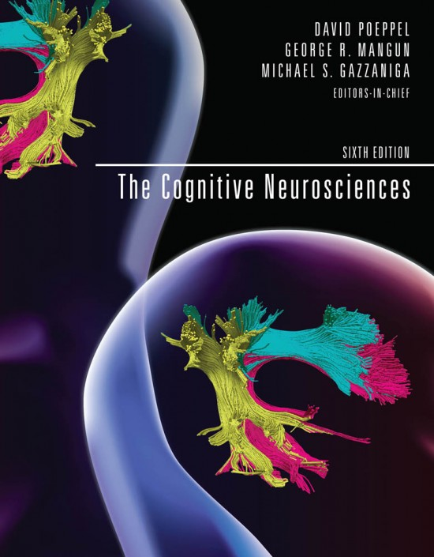

How does the Mind emerge from the Brain? Mind the Gap

Slide 8

“…we do not have a logic for the transformation of neural activity into thought ... I view discerning [this] logic as the most important future direction of neuroscience…”
Richard Axel, Neuron, Sep 2018

Slide 9
What kind of formal theory would qualify as Axel’s “logic”?
Hopfield Nets
A bit specific to storage and retrieval…
Les Valiant’s neuroidal model [1995]
allows for general operations on synapses (e.g., arbitrary state changes)

Slide 10
What are we looking for?
a computational system (why?)
consistent with current understanding of the brain
explains cognitive phenomena
what are the basic data types and the basic operations?

Slide 11
Computation in the Brain: What is the right level?
Whole brain?
Spiking neurons and synapses?
Dendrites?
Molecules?
?

Slide 12
NEMO (NEural MOdel)
A formal probabilistic model of the brain
One basic data type
A few elementary operations
A completeness theorem
A killer app (language!)

Slide 13
Papers
Papadimitriou, Vempala, Mitropolsky, Collins, Maass (2020):
“Computation by assemblies of neurons,” PNAS.
Jung, Mitropolsky, Papadimitriou, Vempala (2021):
“An Interactive Tool for Computation with Assemblies of Neurons”, NeurIPS Demo
Mitropolsky, Collins, Papadimitriou (2021):
“A Biologically Plausible Parser”, TACL.
Dabagia, Papadimitriou, Vempala (2022):
“Assemblies of neurons can learn to classify well-separated distributions,” COLT.
Reid, Vempala (2023):
“The k-Cap Process on Geometric Random Graphs,” COLT.
Dabagia, Papadimitriou, Vempala (2023):
“Computation with Sequences in the Brain,” arXiv preprint.

Slide 14
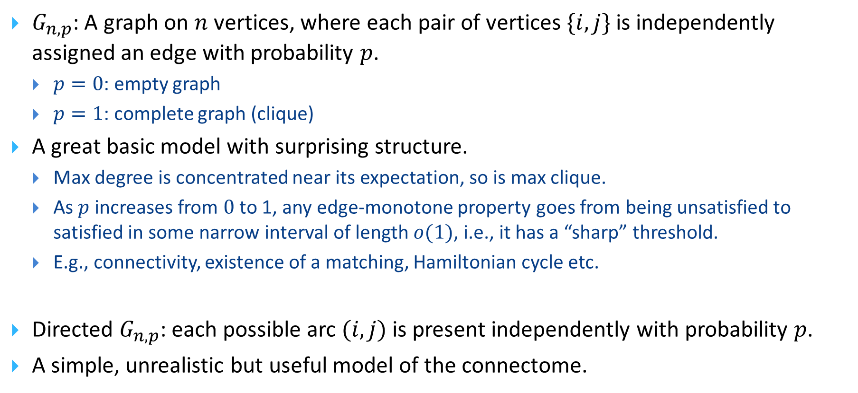
Random Graph
$G_{n,p}$: A graph on $n$ vertices, where each pair of vertices $\{i,j\}$ is independently assigned an edge with probability $p$.
$p=0$: empty graph
$p=1$: complete graph (clique)
A great basic model with surprising structure.
Max degree is concentrated near its expectation, so is max clique.
As $p$ increases from $0$ to 1, any edge-monotone property goes from being unsatisfied to satisfied in some narrow interval of length $o(1)$, i.e., it has a “sharp” threshold.
E.g., connectivity, existence of a matching, Hamiltonian cycle etc.
Directed $G_{n,p}$: each possible arc $(i,j)$ is present independently with probability $p$.
A simple, unrealistic but useful model of the connectome.

Slide 15
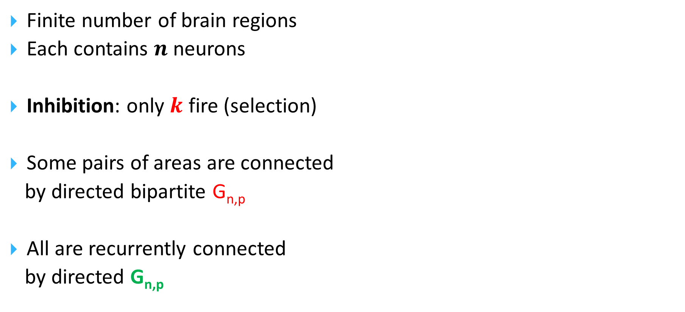
A Mathematical Model of the Brain
Finite number of brain regions
Each contains $n$ neurons
Inhibition: only $k$ fire (selection)
Some pairs of areas are connected
by directed bipartite G_{n,p}
All are recurrently connected
by directed G_{n,p}

Slide 16
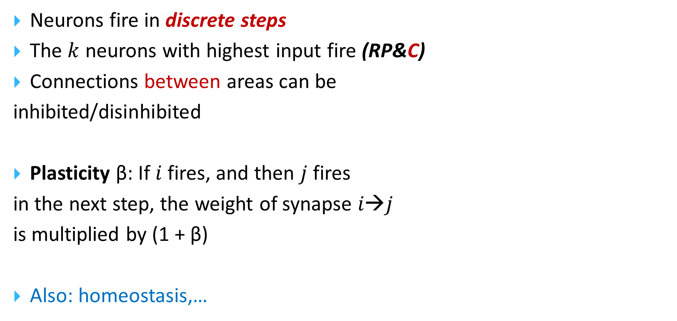
The Model (cont.)
Neurons fire in discrete steps
The $k$ neurons with highest input fire (RP&C)
Connections between areas can be
inhibited/disinhibited
Plasticity β: If $i$fires, and then $j$ fires
in the next step, the weight of synapse $i→j$
is multiplied by (1 + β)
Also: homeostasis,…

Slide 17
How realistic is it?
Reasonably so, for a formal model of the brain
The discrete steps assumption is certainly unrealistic, but likely not distortive
Plasticity and assemblies used in a rapid time scale
A productive compromise between realism and usefulness, allowing us to be rigorous
Q: will computation and learning emerge, rather than have to be “programmed”?

Slide 18
So, back to the question:
What is the basic data type?
(larger than neuron, smaller than brain)?

Slide 19
Assemblies (or ensembles) of neurons
[Hebb 1949, Harris 2003, 2005; Buzsaki 2008, 2010, Yuste et al. 2019,…]
Assembly: A large and densely intraconnected set of excitatory neurons in a brain area whose firing (in a pattern) is tantamount to our thinking of a particular memory, concept, person, name, word, episode, etc.
G. Buzsaki 2020, The Brain Inside Out:
“assemblies are the alphabet of the brain”

Slide 20
The Assembly Hypothesis
There is an intermediate level of brain computation
Call it the Assembly Calculus
It is implicated in higher cognitive functions such as reasoning, planning, language, story-telling, math, music, …
Assemblies of neurons are its basic representation – its “data type”

Slide 21
The Assembly Hypothesis (cont.)
What are the operations of the Assembly Calculus?
Project
Associate
Pattern complete
Merge
Bind (or reciprocal project)
...plus a few control commands

Slide 22
Projection of an assembly: (RP&C)*
Assembly
Also, Hebbian
plasticity

Slide 23
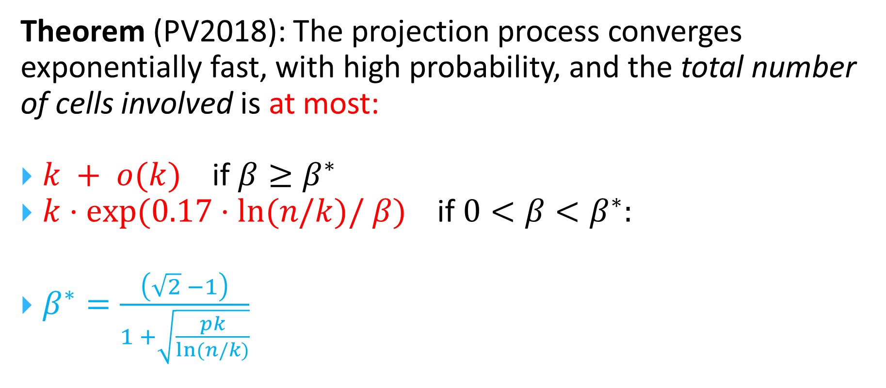
Convergence of (RP&C)* to an Assembly
Theorem (PV2018): The projection process converges exponentially fast, with high probability, and the total number of cells involved is at most:
$k + o(k)$ if $β≥β^{∗}$
$k⋅exp⁡(0.17⋅ln⁡(n/k)/ β)$ if $0<β<β^{∗}:$
$β^{∗}=\frac{\left(\sqrt{2} −1\right)}{1 +\sqrt{\frac{pk}{ln(n/k)}}}$

Slide 24
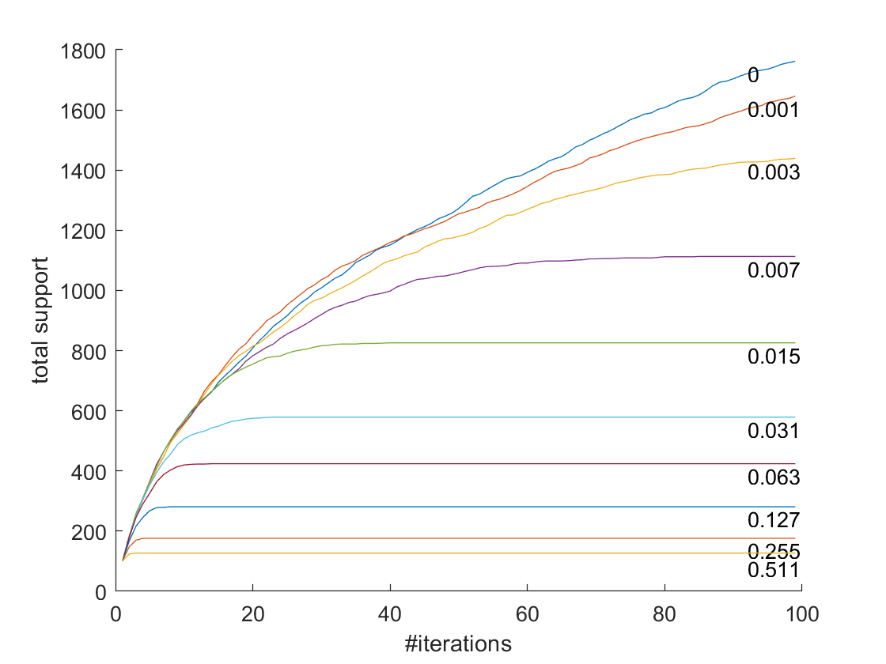
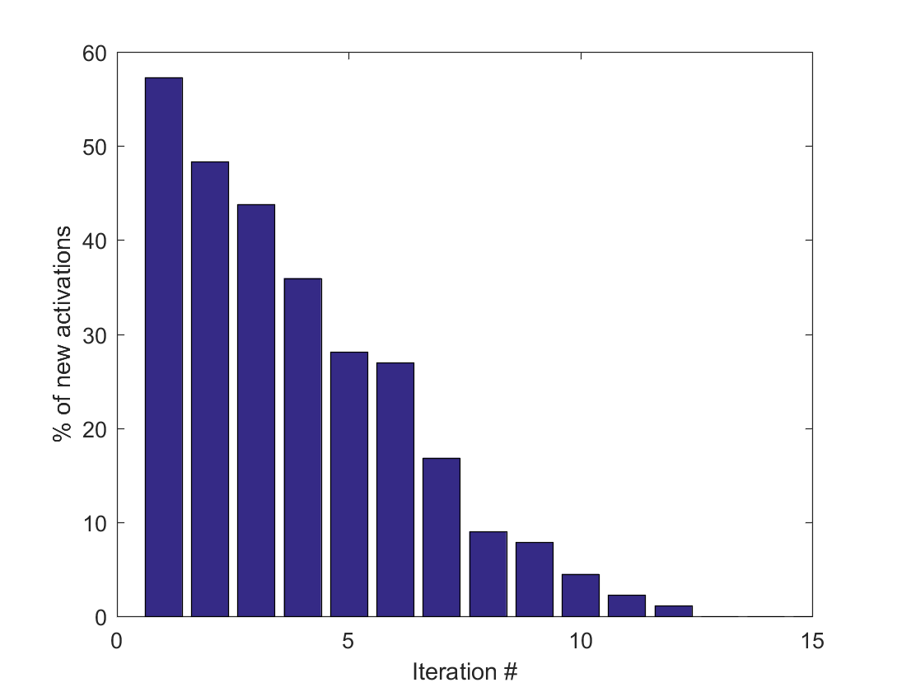
n=2000, k=100

Slide 25
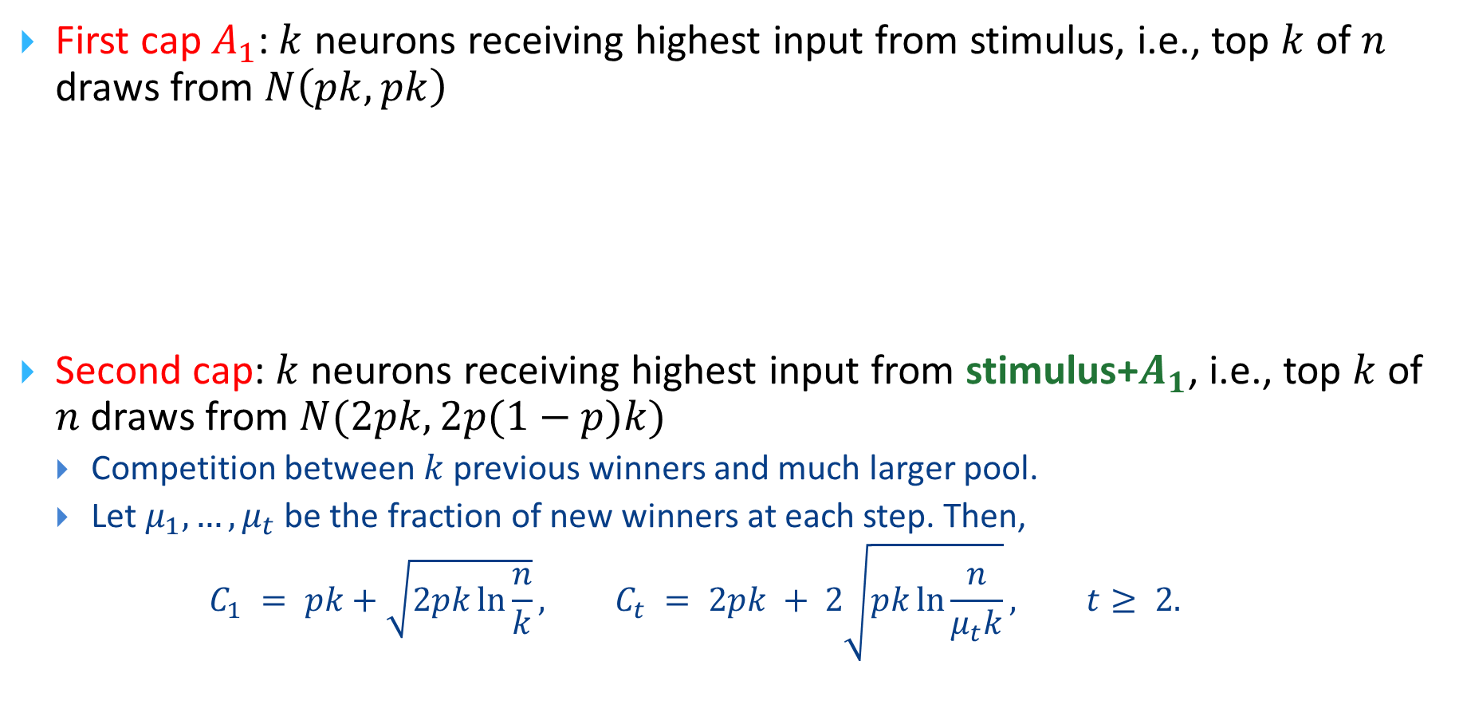
Proof of Convergence
First cap $A_{1}$: $k$ neurons receiving highest input from stimulus, i.e., top $k$ of $n$ draws from $N\left(pk,pk\right)$
Second cap: $k$ neurons receiving highest input from stimulus+$A_{1}$, i.e., top $k$ of $n$ draws from $N(2pk,2p(1−p)k)$
Competition between $k$ previous winners and much larger pool.
Let $μ_{1},…,μ_{t}$ be the fraction of new winners at each step. Then,
$$C_{1} = pk+\sqrt{2pk\ln{\frac{n}{k}}}, C_{t} = 2pk + 2\sqrt{pk\ln{\frac{n}{μ_{t}k}}}, t≥ 2.$$

Slide 26
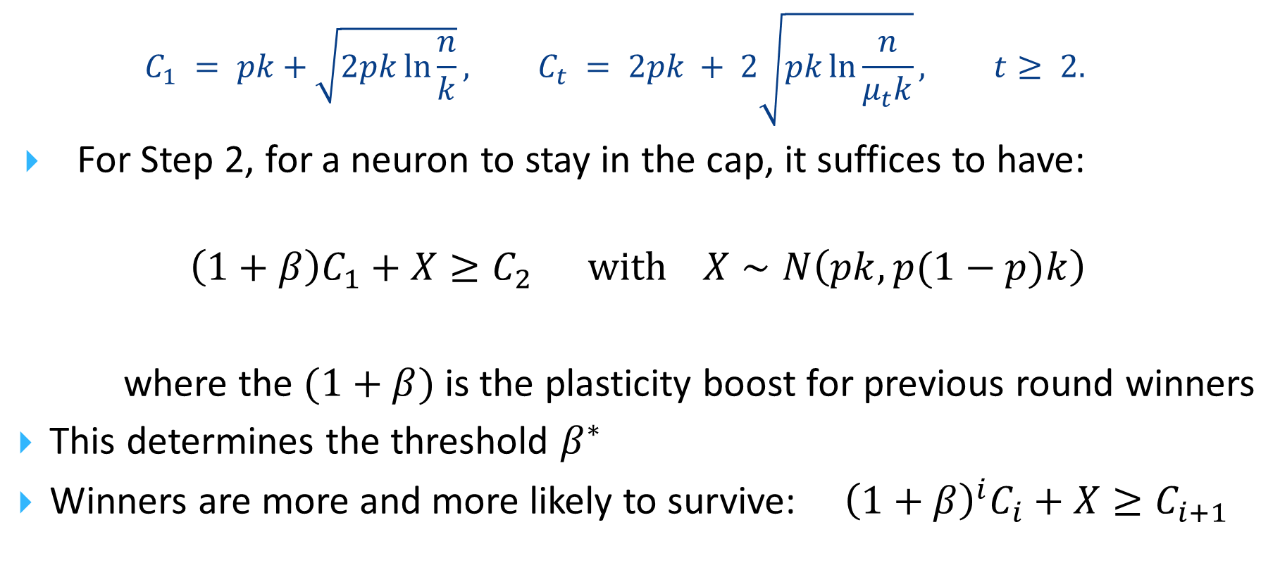
Proof of Convergence
$$C_{1} = pk+\sqrt{2pk\ln{\frac{n}{k}}}, C_{t} = 2pk + 2\sqrt{pk\ln{\frac{n}{μ_{t}k}}}, t≥ 2.$$
For Step 2, for a neuron to stay in the cap, it suffices to have:
$$\left(1+β\right)C_{1}+X≥C_{2} with X∼N\left(pk,p(1−p)k\right)$$
where the $(1+β)$ is the plasticity boost for previous round winners
This determines the threshold $β^{∗}$
Winners are more and more likely to survive: ${\left(1+β\right)}^{i}C_{i}+X≥C_{i+1}$

Slide 27
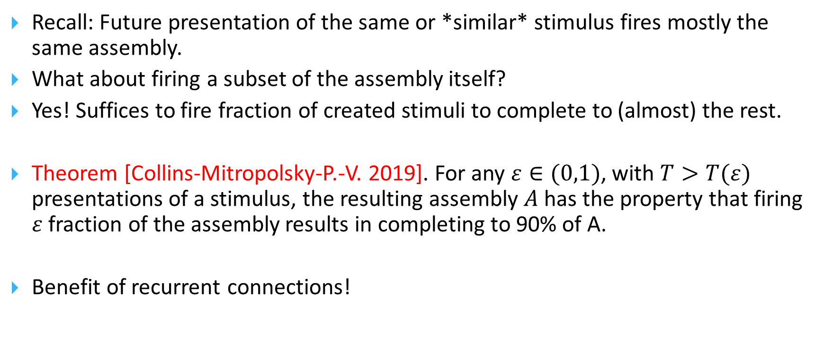
Pattern Completion
Recall: Future presentation of the same or *similar* stimulus fires mostly the same assembly.
What about firing a subset of the assembly itself?
Yes! Suffices to fire fraction of created stimuli to complete to (almost) the rest.
Theorem [Collins-Mitropolsky-P.-V. 2019]. For any $ε∈(0,1)$, with $T>T(ε)$ presentations of a stimulus, the resulting assembly $A$ has the property that firing $ε$ fraction of the assembly results in completing to 90% of A.
Benefit of recurrent connections!

Slide 28
Association of Two Assemblies
assembly
representations
two
stimuli

Slide 29
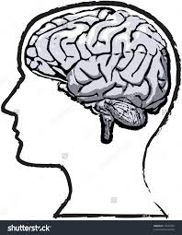
The [Ison et al. 2016] experiment

Slide 30
The [Ison et al. 2016] experiment

Slide 31
The [Ison et al. 2016] experiment

Slide 32


Slide 33


Slide 35


Slide 36


Slide 40
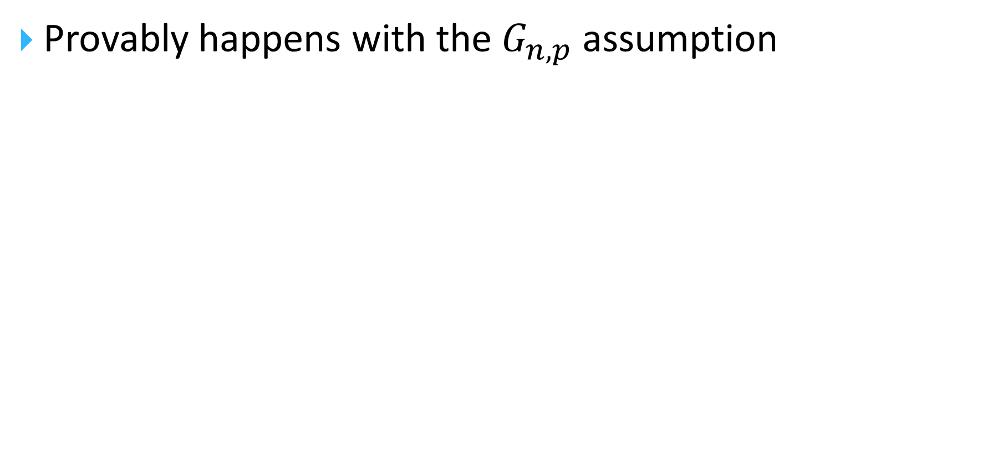
Association
Provably happens with the $G_{n,p}$ assumption

Slide 41
Merge: a more complicated operation
…and useful for Language (Berwick-Chomsky)

Slide 42
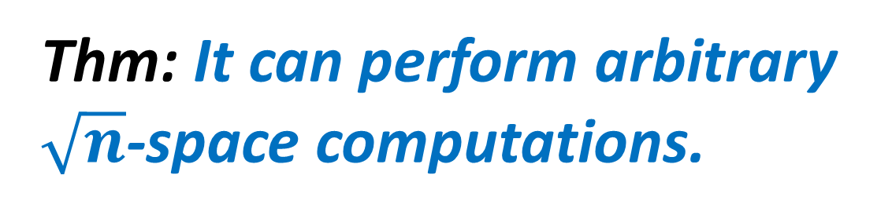
Assembly Calculus recap
project(y, B, x)
associate(x, y)
pattern_complete(x, y)
merge(x, y, B, z)
and control commands: activate(x), read(), disinhibit(A)
Q: How powerful is this system?
Thm: It can perform arbitrary $\sqrt{n}$-space computations.

Slide 43
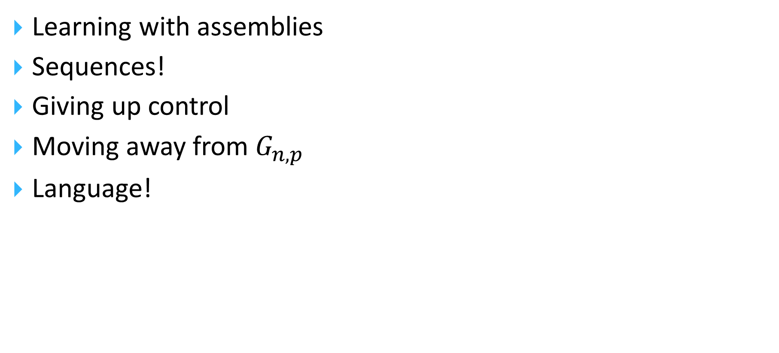
In the rest of the talk
Learning with assemblies
Sequences!
Giving up control
Moving away from $G_{n,p}$
Language!

Slide 44
Learning: How do brains learn?
Crucial problem for NEMO / Assembly Calculus
Locally: plasticity
Globally: does the brain do Gradient Descent (GD)?
A topic of debate, with little evidence that it does.
Is synaptic plasticity an effective learning mechanism?

Slide 45
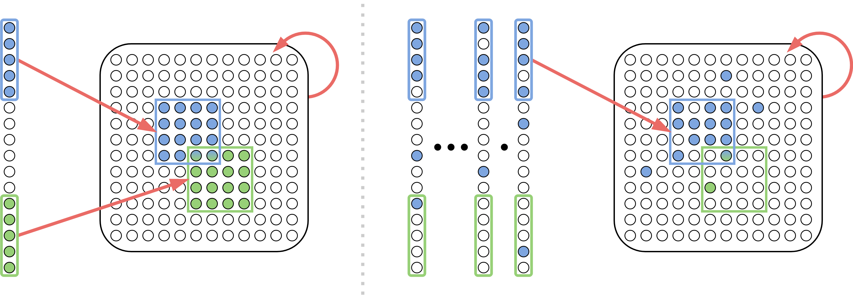
Unsupervised Learning with Assemblies
Question: We know that the assembly projection process preserves overlap. But can it create assemblies to represent clusters of data, i.e., higher-level assemblies?

Slide 46
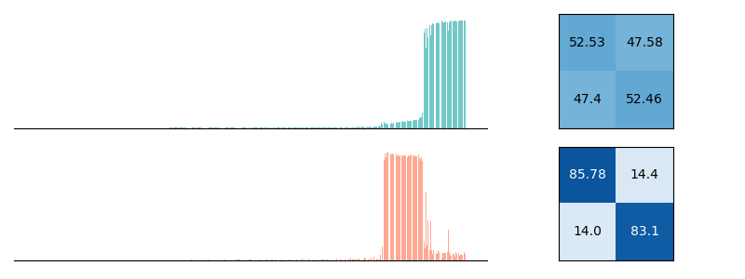


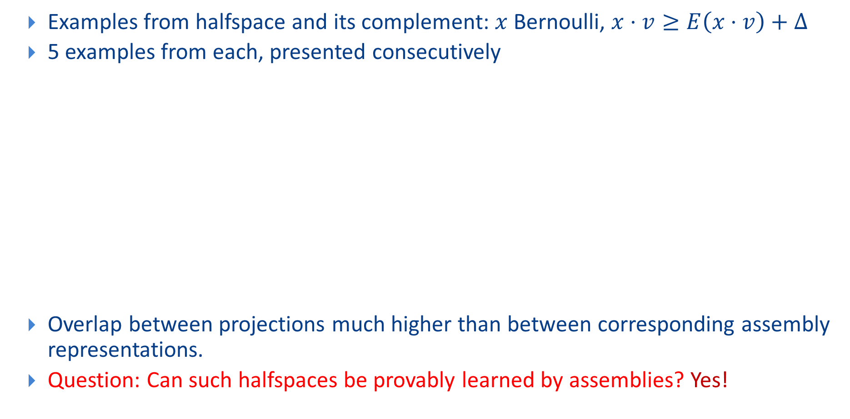
Mildly supervised Learning of Halfspaces?
Examples from halfspace and its complement: $x$ Bernoulli, $x⋅v≥E\left(x⋅v\right)+Δ$
5 examples from each, presented consecutively
Overlap between projections much higher than between corresponding assembly representations.
Question: Can such halfspaces be provably learned by assemblies? Yes!

Slide 47
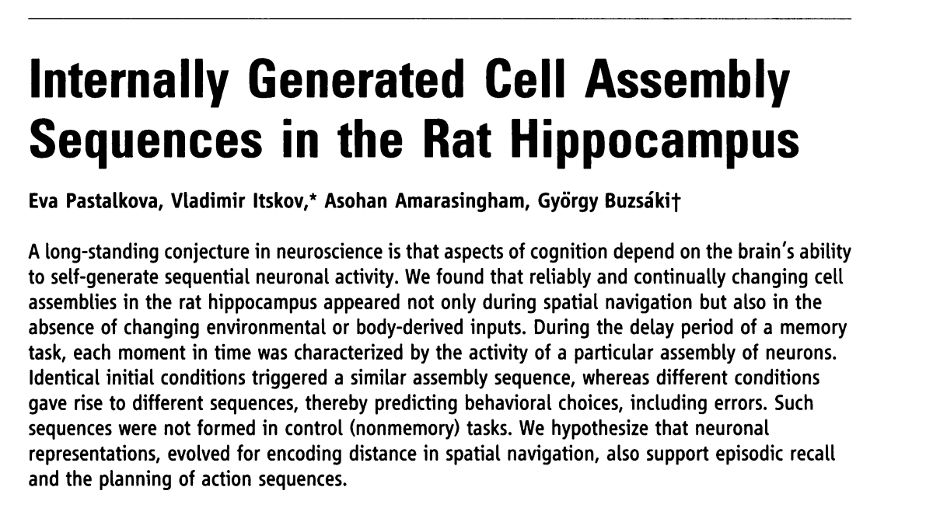
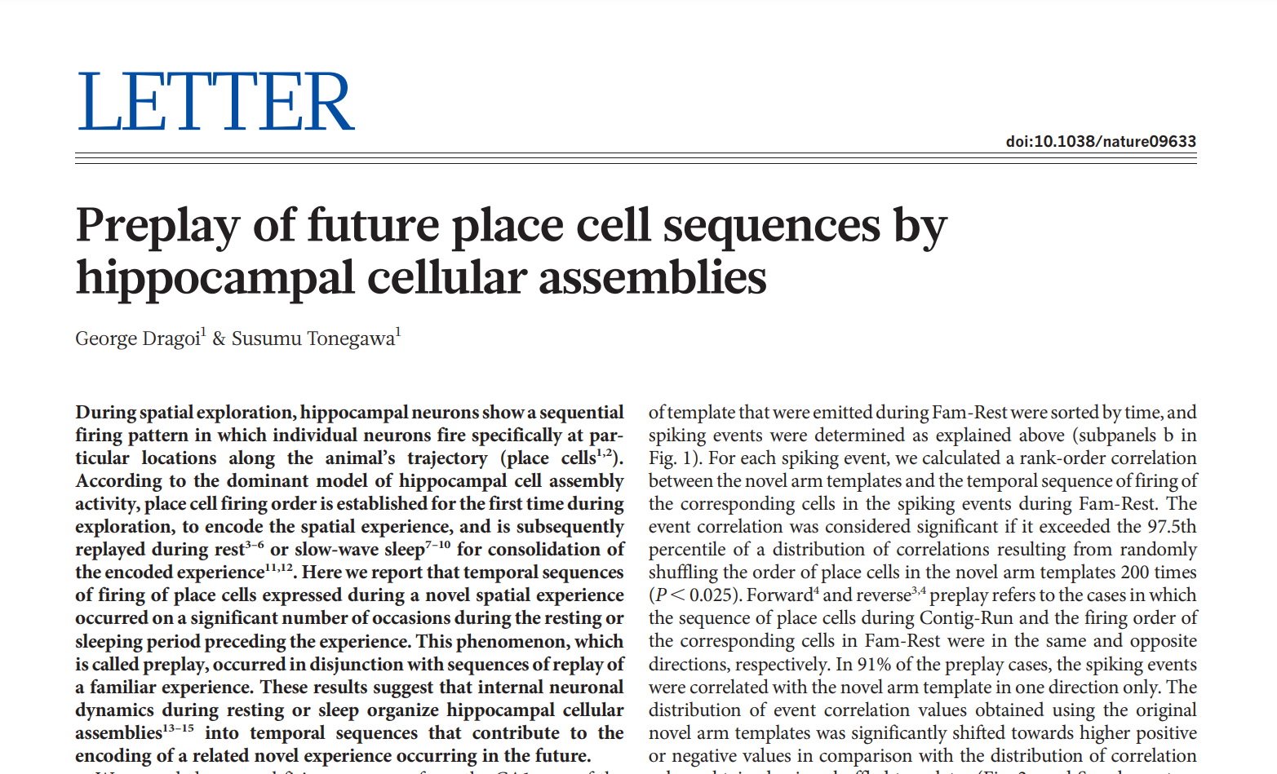
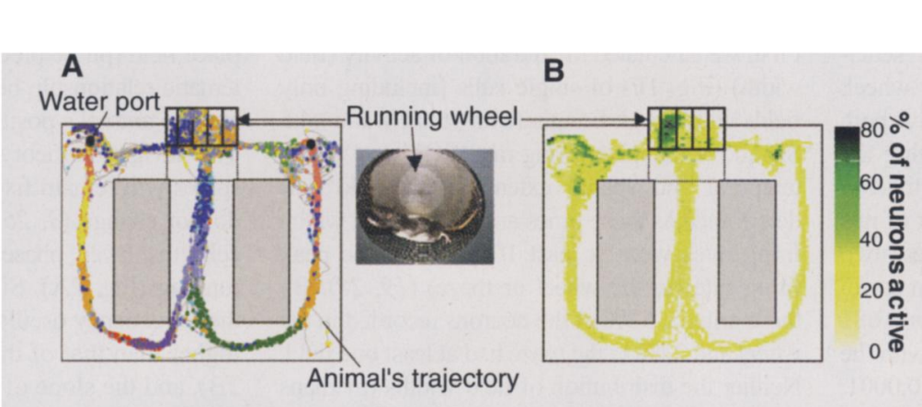
Sequences!
Memorizing and Learning sequences of stimuli seems very natural to brains.
a-b-c-d…, songs, poems, stories,…
Assembly sequences observed in experiments!

Slide 48
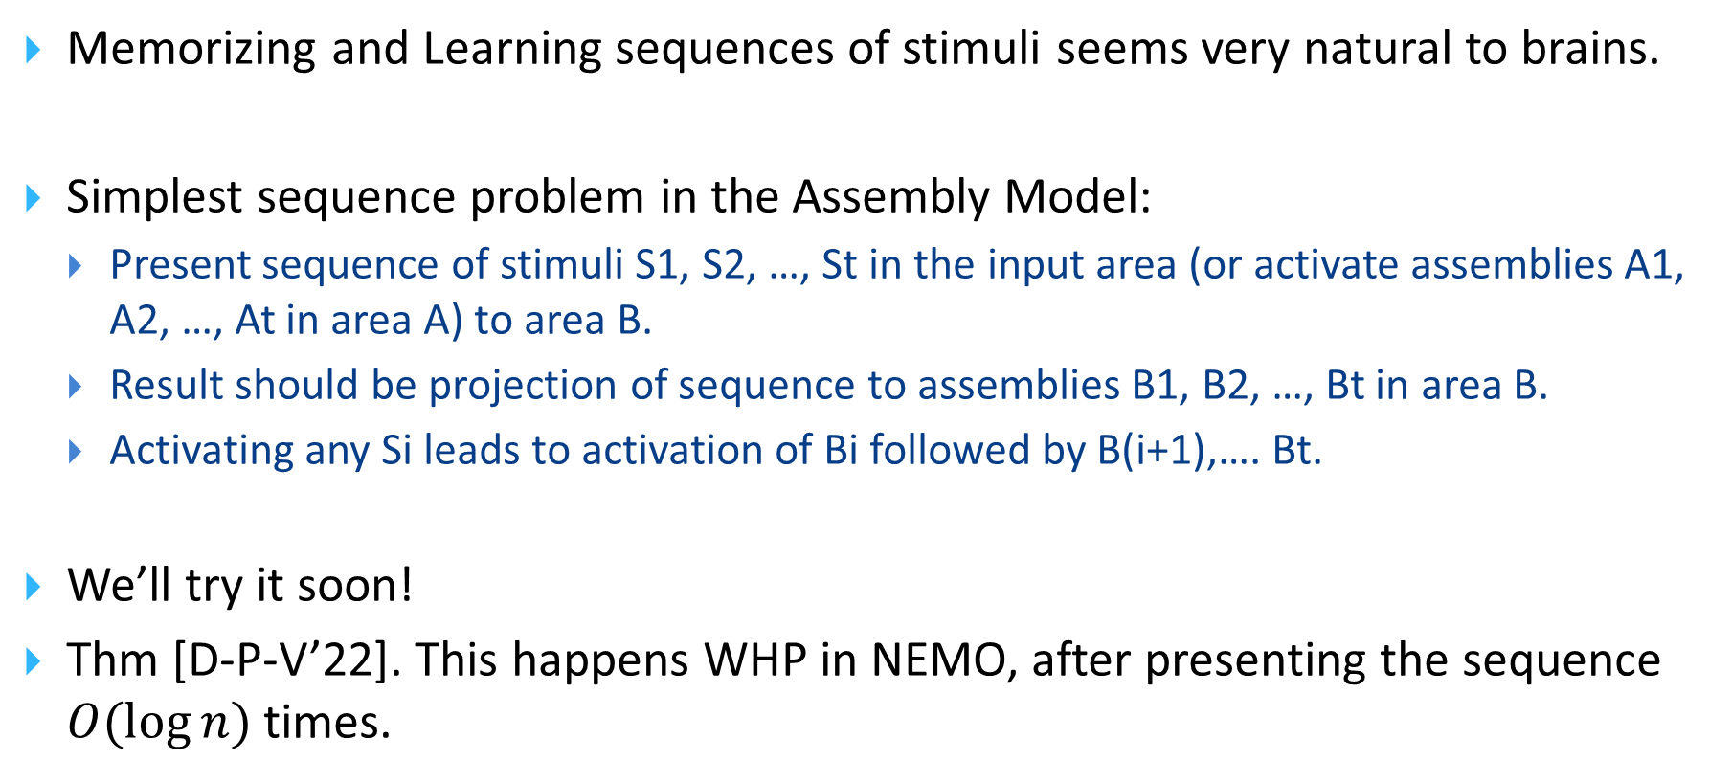
Sequences!
Memorizing and Learning sequences of stimuli seems very natural to brains.
Simplest sequence problem in the Assembly Model:
Present sequence of stimuli S1, S2, …, St in the input area (or activate assemblies A1, A2, …, At in area A) to area B.
Result should be projection of sequence to assemblies B1, B2, …, Bt in area B.
Activating any Si leads to activation of Bi followed by B(i+1),…. Bt.
We’ll try it soon!
Thm [D-P-V’22]. This happens WHP in NEMO, after presenting the sequence $O(\log{n})$ times.

Slide 49








Sequences!
Powerful consequences:
Finite State Automata
Algorithms are finite-state machines; we learn them by simply being exposed to their rules.
General-purpose simulation of Turing machine by simply presenting appropriate input sequence!

Slide 50

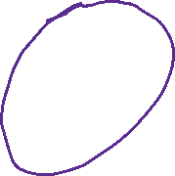
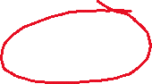


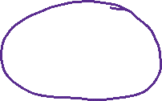
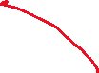
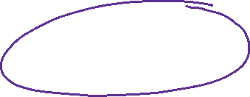
Brain computation without control commands
Both FSMs and TMs operate in the AC without control commands
Long-Range Interneurons whose firing can inhibit/disinhibit an entire area
For FSM’s, we we just need alternation between firing areas
General-purpose simulation of Turing machine without control commands by simply presenting appropriate input sequence!

Slide 51








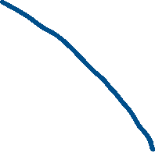



The benefits of (long-range) inhibition
Goal: make areas A and B fire alternately
Populations of inhibitory neurons to inhibit: $I_{A},I_{B}$ and to disinhibit: $D_{A},D_{B}$
A
B
$$I_{A}$$
$$I_{B}$$
$$D_{A}$$
$$D_{B}$$

Slide 52
Brain computation without control commands
The realization and execution of finite-state machines is emergent computation, provably --- an appropriate sequence of inputs, components of the AC operating by their local rules, and no overall control!
https://github.com/mdabagia/learning-with-assemblies

Slide 53
Finally, Language!
A last-minute adaptation
It evolved to exploit the brain’s strengths
Invaluable lens for studying the brain
A deluge of recent experiments!

Slide 54
…this text pulsates at four Hertz, the rhythm of four bits per second, and you may find this rhythm a bit familiar, because it coincides with the rhythm of speech, and I don’t mean my speech or your speech, but speech in general, by all speakers, in all languages, worldwide.

Slide 55
…in contrast, this text pulsates a dozen times faster at fifty Hertz, the rhythm of spiking neurons in the Brain…

Slide 56
The [Poeppel 2016] experiment
fret
ship
hill
give
true
melt
fans
blue
guess
hits
then
cats
4 hertz

Slide 57
The [Poeppel 2016] experiment, stage II
bad
cats
eat
fish
new
plan
gave
joy
little
boy
kicks
ball
1 2 4 hertz

Slide 58
Our interpretation
bad
cats
eat
fish
new
plan
gave
joy
little
boy
kicks
ball
1 2 4 hertz

Slide 59
Zaccarella & Friedericci “Merge in the human Brain” Front. Psych. 2015
The completion of phrases, and especially of sentences, activates parts of Broca’s area

Slide 60
Assemblies and Language: Syntax Trees
Can each tree-building step be accomplished by about a dozen spikes?
Analytical results and simulations show that projection creates a new assembly by spiking repeatedly a few times! (~12)
projected
assembly
assembly of neurons

Slide 61
Many Research Directions!
On the Assembly Calculus
Emergent computation: input and mechanism, no algorithm!
(removes one level of David Marr’s 3-level framework for brain)
Random graph models of the connectome
Sparsification, plasticity, and Brain Organization
Learning with Assemblies
Language: word embeddings, analogies and reasoning with neural assemblies, next-token prediction with NEMO

Slide 62
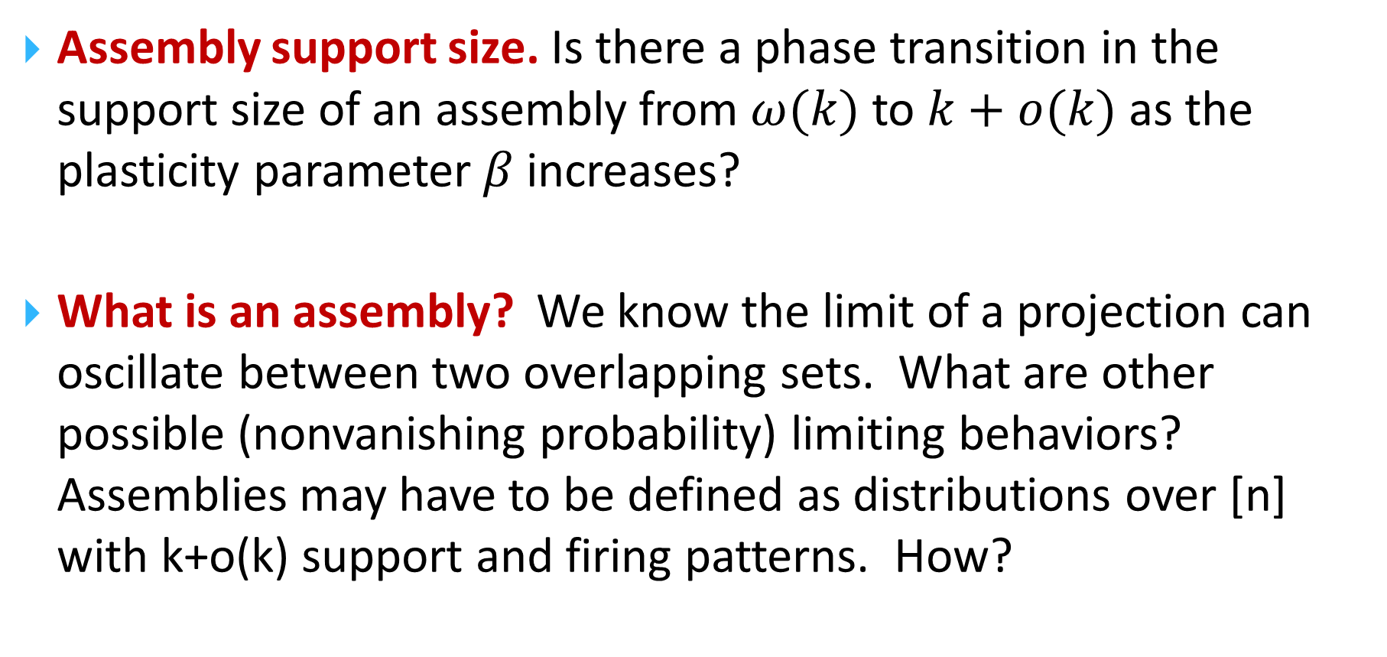
Open problems related to Assemblies and Convergence
Assembly support size. Is there a phase transition in the support size of an assembly from $ω(k)$ to $k+o(k)$ as the plasticity parameter $β$ increases?
What is an assembly? We know the limit of a projection can oscillate between two overlapping sets. What are other possible (nonvanishing probability) limiting behaviors? Assemblies may have to be defined as distributions over [n] with k+o(k) support and firing patterns. How?

Slide 63
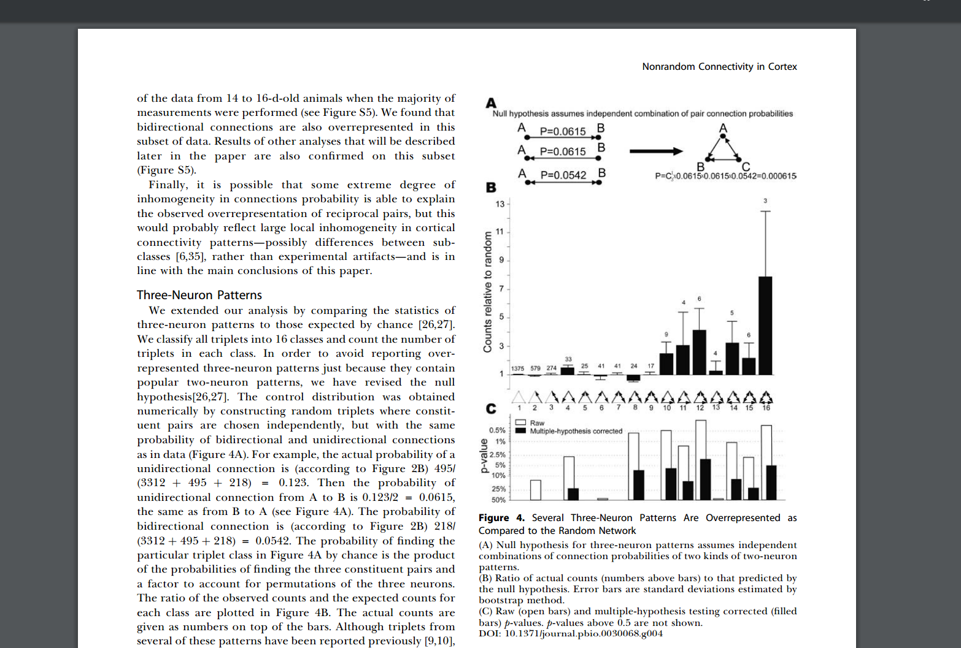
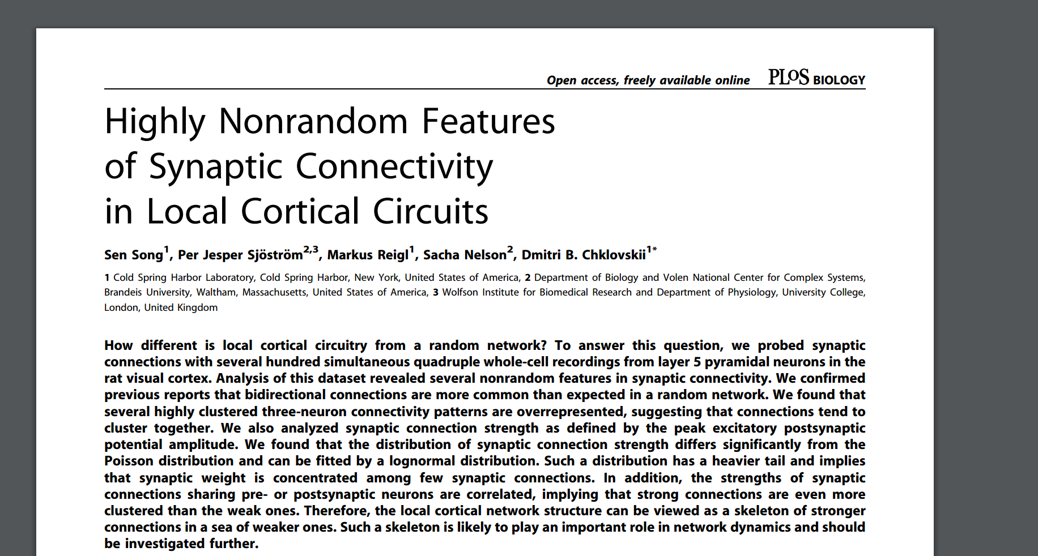
Nonrandom features of the Connectome
[Song et al 2005]: reciprocity and triangle completion
G_{n,p}
p ~ 10⁻²
G_{n,p}++
p ~ 10⁻¹

Slide 64
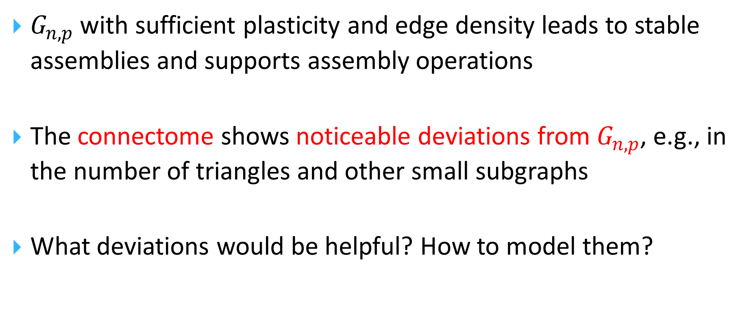
Random Graph models
$G_{n,p}$ with sufficient plasticity and edge density leads to stable assemblies and supports assembly operations
The connectome shows noticeable deviations from $G_{n,p}$, e.g., in the number of triangles and other small subgraphs
What deviations would be helpful? How to model them?

Slide 65

Departures from $G_{n,p}$
They seem to strengthen the convergence results for Projection
Reciprocity increases assembly density; triangle completion begets a birthday paradox phenomenon
Conjecture: Assembly operations become provably more robust in the presence of these “departures.”

Slide 66
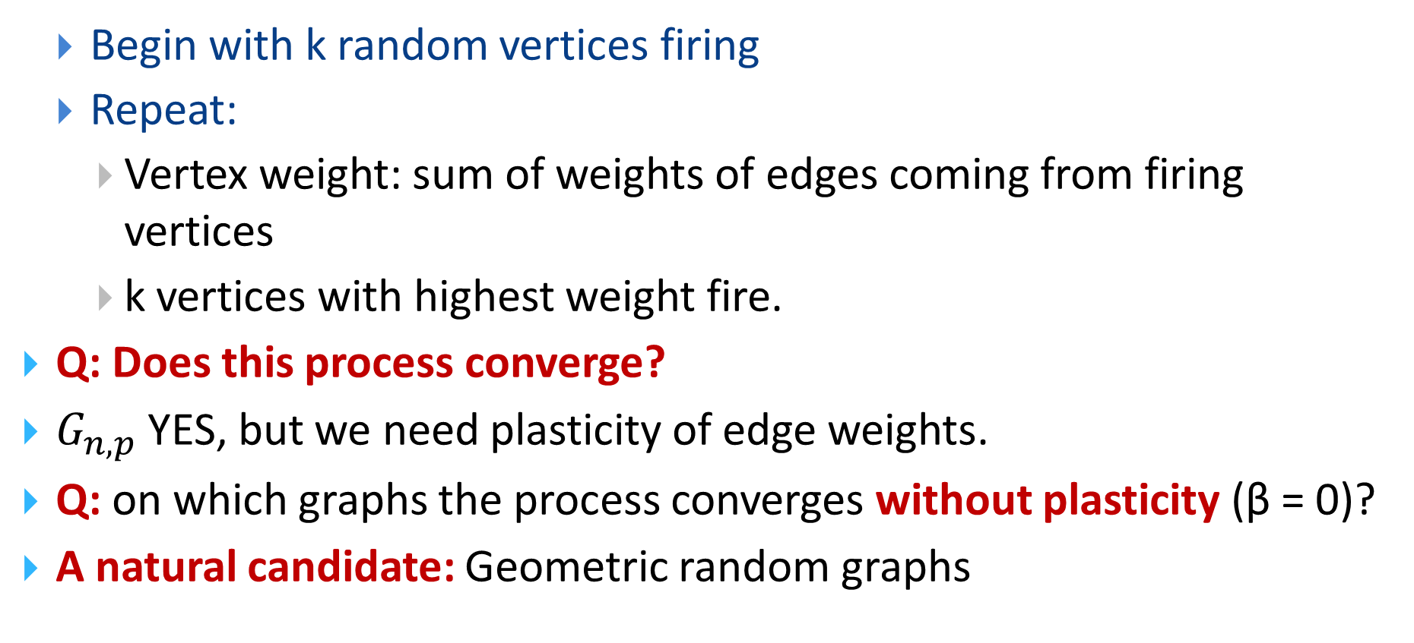
A Fundamental Convergence Problem
Begin with k random vertices firing
Repeat:
Vertex weight: sum of weights of edges coming from firing vertices
k vertices with highest weight fire.
Q: Does this process converge?
$G_{n,p}$ YES, but we need plasticity of edge weights.
Q: on which graphs the process converges without plasticity (β = 0)?
A natural candidate: Geometric random graphs

Slide 67
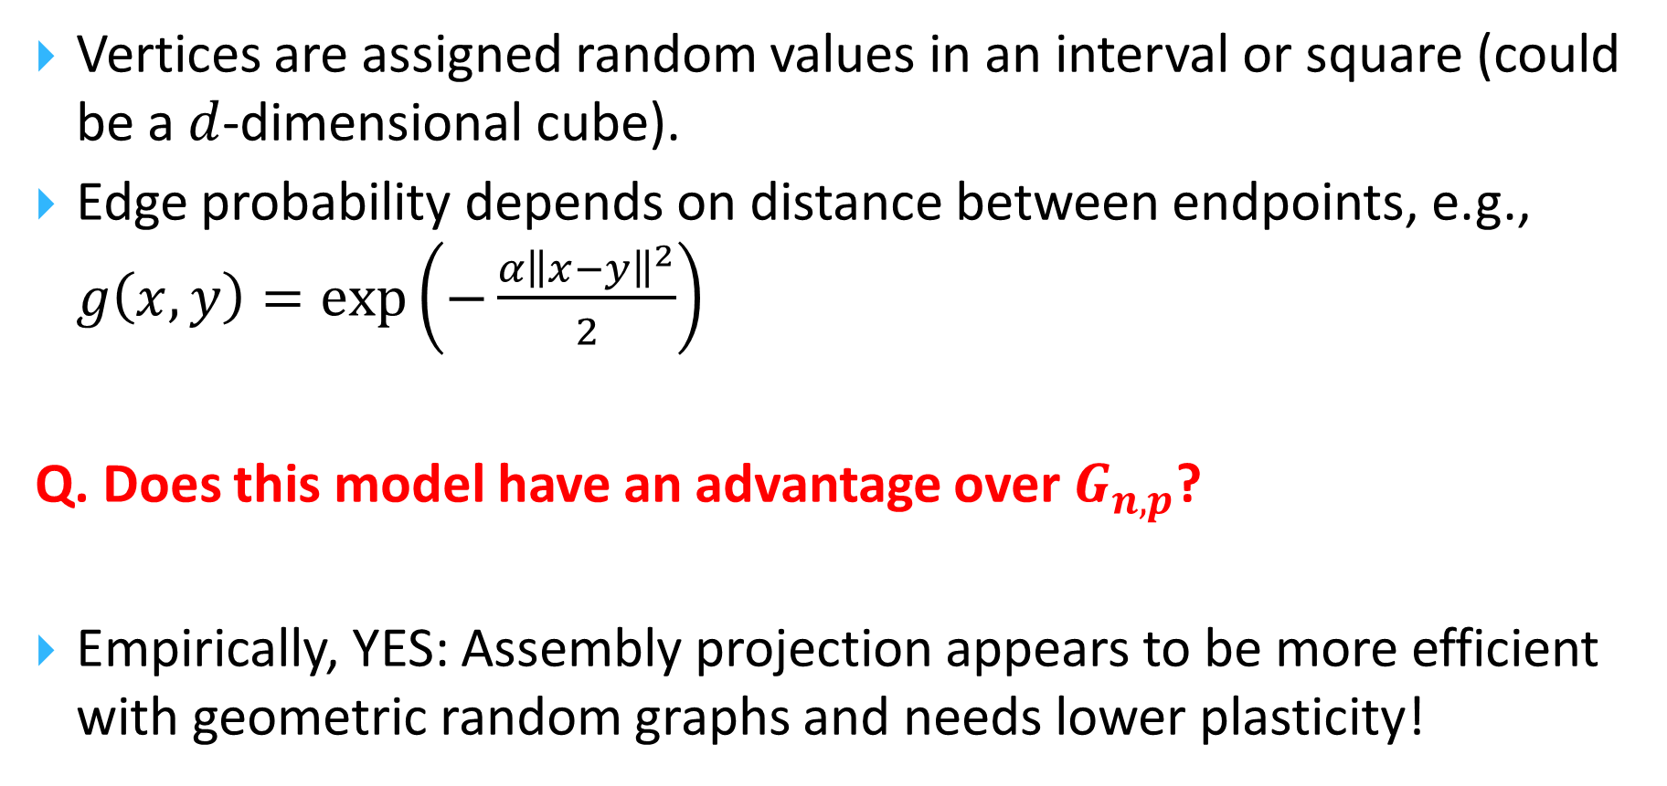
Geometric Random Graphs
Vertices are assigned random values in an interval or square (could be a $d$-dimensional cube).
Edge probability depends on distance between endpoints, e.g., $g\left(x,y\right)=\exp\left(−\frac{α{\left\|x−y\right\|}^{2}}{2}\right)$
Q. Does this model have an advantage over $G_{n,p}$?
Empirically, YES: Assembly projection appears to be more efficient with geometric random graphs and needs lower plasticity!

Slide 68
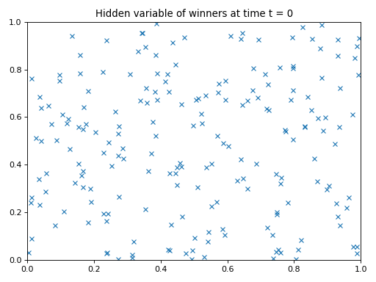
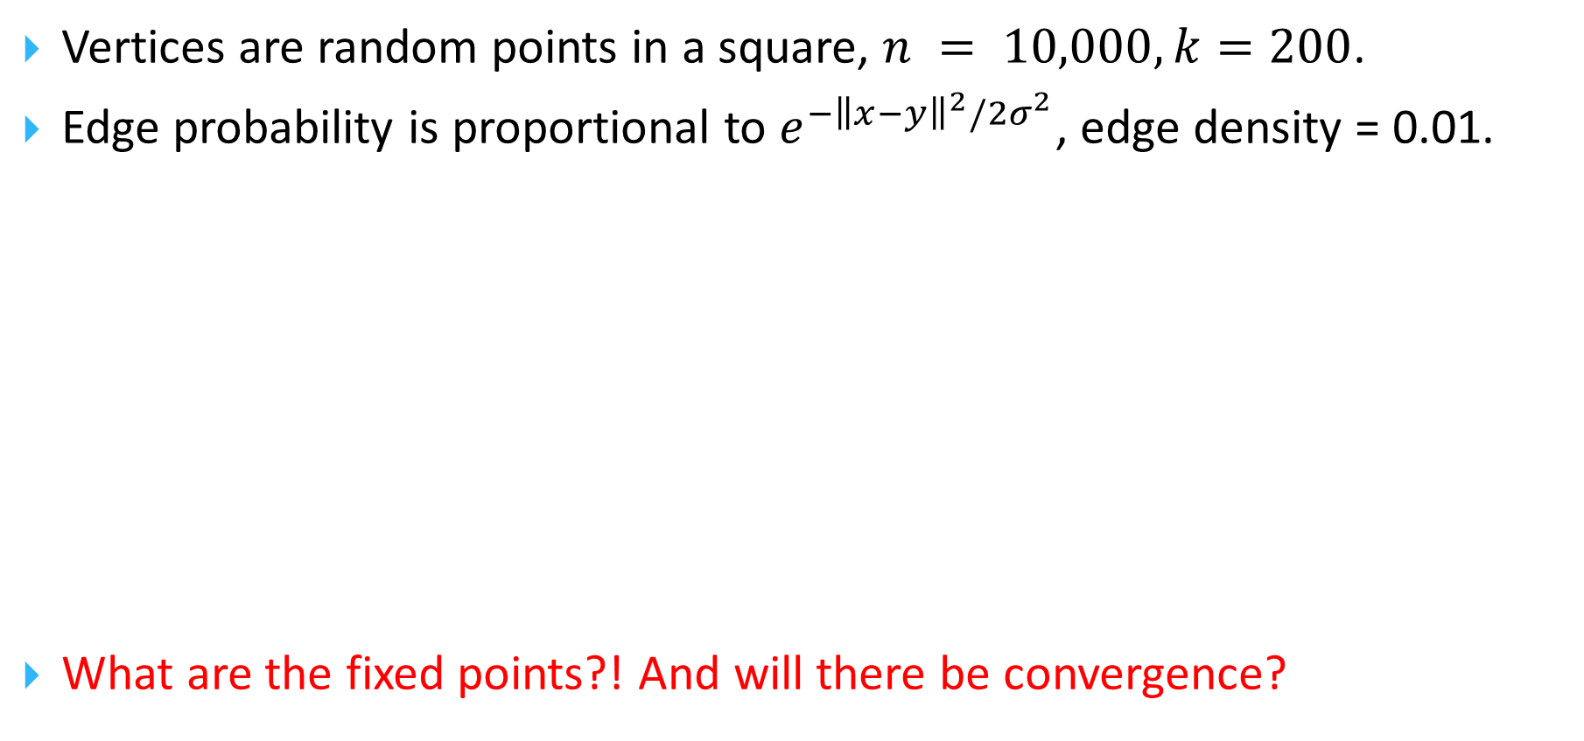
Convergence on Geometric Random Graphs
Vertices are random points in a square, $n = 10,000, k=200$.
Edge probability is proportional to $e^{−{\left\|x−y\right\|}^{2}/2σ^{2}}$, edge density = 0.01.
What are the fixed points?! And will there be convergence?

Slide 69
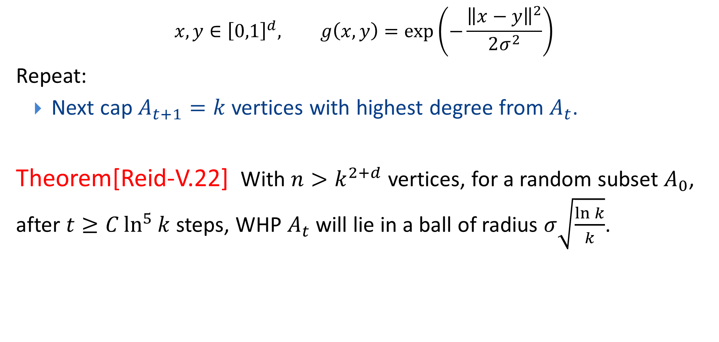
Convergence on Geometric Gaussian Graphs
$$x,y∈{\left[0,1\right]}^{d}, g\left(x,y\right)=\exp\left(−\frac{{\left\|x−y\right\|}^{2}}{2σ^{2}}\right)$$
Repeat:
Next cap $A_{t+1}=k$ vertices with highest degree from $A_{t}$.
Theorem[Reid-V.22] With $n>k^{2+d}$ vertices, for a random subset $A_{0}$, after $t≥C\ln^{5}{k}$ steps, WHP $A_{t}$ will lie in a ball of radius $σ\sqrt{\frac{\ln{k}}{k}}$.

Slide 70
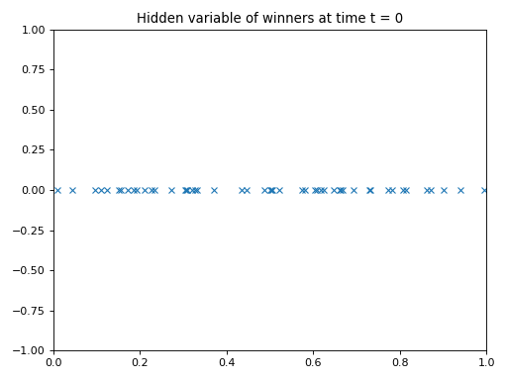
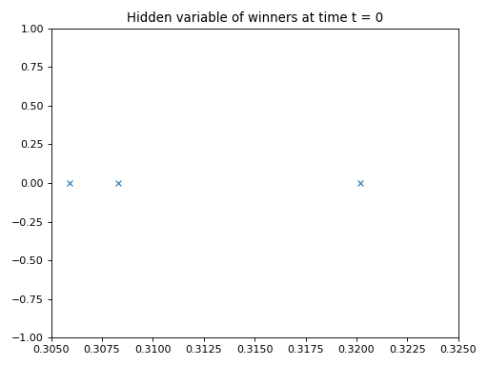
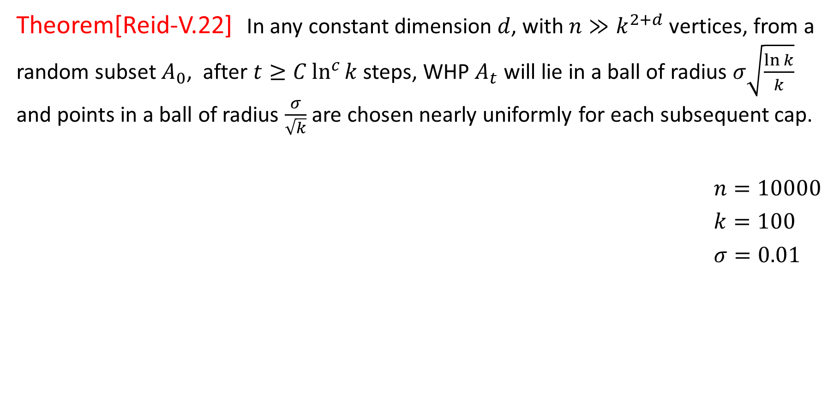
Convergence on Geometric Gaussian Graphs
Theorem[Reid-V.22] In any constant dimension $d$, with $n≫k^{2+d}$ vertices, from a random subset $A_{0}$, after $t≥C\ln^{c}{k}$ steps, WHP $A_{t}$ will lie in a ball of radius $σ\sqrt{\frac{\ln{k}}{k}}$ and points in a ball of radius $\frac{σ}{\sqrt{k}}$ are chosen nearly uniformly for each subsequent cap.
$n=10000$
$k=100$
$σ=0.01$

Slide 71
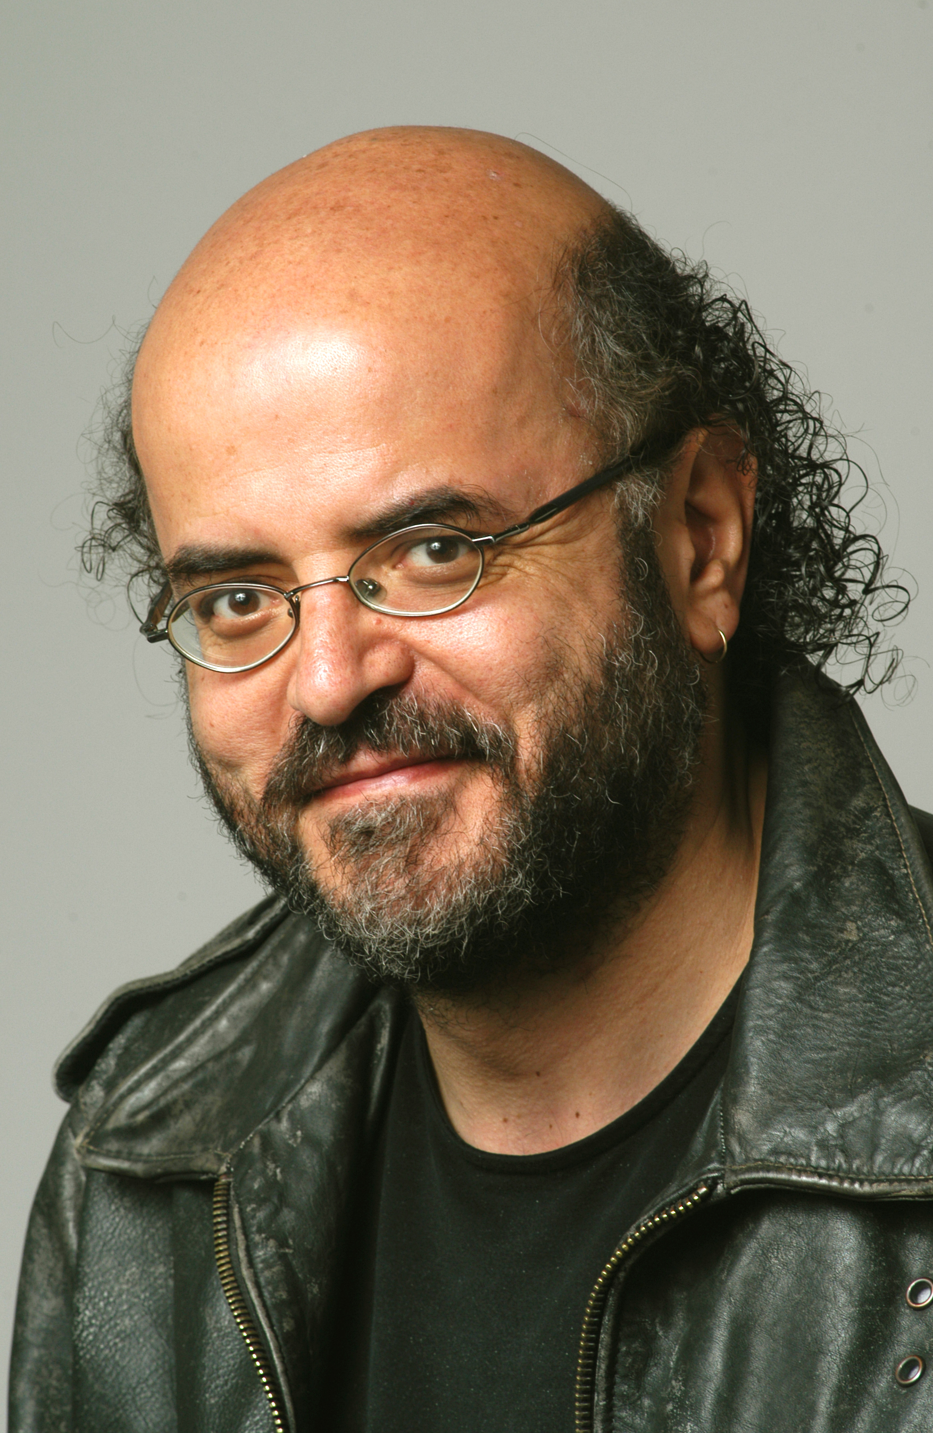






Thanks to
Christos Papadimitriou
Dan Mitropolsky, Mike Collins, Wolfgang Maass
Max Dabagia, Mirabel Reid, Seung Je Jung
… and to you!

Slide 72
Less …. is More?
Tiny working memory
Slow, serial processing
Very little energy usage
But robustly accomplishes a range of cognitive tasks
How? What (computational) ideas are we missing?!

